Slide 1


Dipinder Benipal
December 7, 2021

Slide 2

Outline
Executive Summary
Introduction
Methodology
Results
Conclusion
Appendix

Slide 3
Executive Summary
Summary of methodologies
Data Collection using REST APIs and Web Scraping
Data Wrangling to clean and aggregate data using Python Pandas and SQL
EDA with Data Visualization and SQL
Building Interactive Maps and Dashboards (via Folium and Plotly Dash)
Testing General ML Models to find the best fit using train and test samples.
Summary of all results
EDA results indicate better performance of low weighted payloads.
Tree Classifier Algorithm is best used for the data set.
Success rate continues to increase over time.
Launch Sites and Orbits also play a role in success rates.

Slide 4
Introduction
Project Goals and Context
Project goal is to determine if we can predict whether the first stage of a Falcon 9 rocket will land successfully. The motivation behind this is that being able to reuse first stages of a launch drastically reduces the cost of a launch, and those savings allow for more efficient budget allocation. The information gained from this data can help alternate companies bid against SpaceX and improve their own launches.
Problems that needed solving
Determining what factors have correlation with successful launches.
Determining how those correlations will impact the success rate.
Determining the best conditions and best model to predict a successful launch.

Slide 5


Slide 6
Methodology
Gather relevant data using REST APIs and by web scraping online sources. Clean, transform and aggregate the data so that we can perform EDA using visualizations and SQL queries. Finally, build and evaluate models for predicting future launch success rates.
Data collection methodology:
Made requests to the SpaceX APIs to gather reliable data from the source.
Used BeautifulSoup to find and parse tables on Wikipedia for data on launches.
Perform data wrangling
Filtered the data to contain relevant features, cleaned and replaced missing data.
One Hot Encoding categorical fields to prepare them for ML Models.
Perform exploratory data analysis (EDA) using visualization and SQL
Perform interactive visual analytics using Folium and Plotly Dash
Perform predictive analysis using classification models
How to build, tune, evaluate classification models to determine best model for prediction.
Data Collection
Data Wrangling
Exploratory Data Analysis
Interactive Visual Analytics
Predictive Model Analysis

Slide 7
Data Collection
To gather the required data, the following methods were used:
Using Python to access the SpaceX REST API and retrieve the data in JSON format.
The API provided data on the types of rockets used, launch specifications such as location and orbit, the type of payload delivered and the landing outcomes.
The BeautifulSoup library in Python was also useful in obtaining Falcon 9 Launch Data, by web scraping tables off Wikipedia.
Connect to the SpaceX REST API
Get the data in .JSON by making request calls and reformat into flat data
Clean the data and store the tabulated data into a .csv file
Get the HTML Response from Wikipedia
Extract relevant data by using BeautifulSoup to parse the tables
Reformat the data into tabular form and store into a .csv file

Slide 8
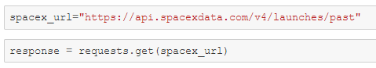
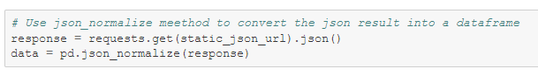

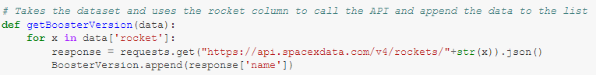
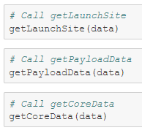

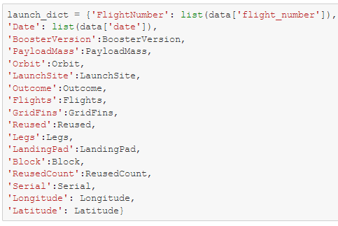
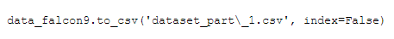
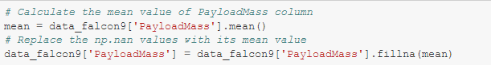
Connect to the Spacex REST API
Retrieve the Relevant Data
Clean and Structure the Data
Store the data in a .csv file.
Data Collection – SpaceX API
1. Connect to the SpaceX REST API
2. Retrieve the Relevant Data
GitHub Notebook Link
3. Clean and Structure the Data
4. Store the data in a .csv file

Slide 9
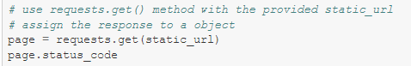

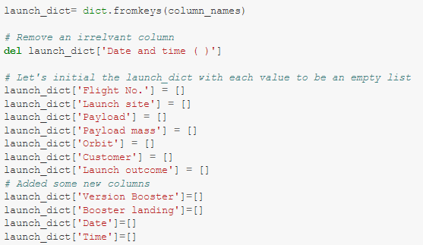
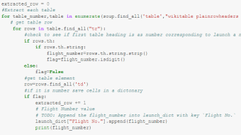
Get HTML response from Wikipedia
Extract Data using BeautifulSoup to Parse Tables
Store the data in a .csv file.
Data Collection - Scraping
1. Get HTML Response from Wikipedia
2. Extra Data using BeautifulSoup to Parse Tables
GitHub Notebook Link
3. Store the Data in a .csv file
Code to build dictionary data structure
Code to append data dictionary using BeautifulSoup

Slide 10
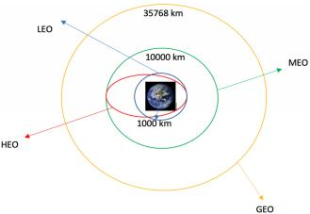
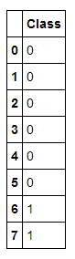
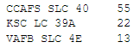
Data Wrangling
Introduction
Once the data had been retrieved and formatted into tabular data, the cleaning process was relatively simple. The key changes made were to drop several columns deemed excess to analysis, so that we could focus on key features. Some simple EDA was also performed on some of the columns to get a better understanding of the data. Furthermore, since the landing outcomes column was multi-class, it was transformed to be a binary column reflecting only successful or failed landings. All “True%” landing outcomes were considered successes, with the rest all falling under failures. From there, once a few missing cells were collected, the data was ready for aggregation and analysis.
Diagram of some of the Orbital Designations illustrating how different orbits for each launch can be
Retrieve Data and filter dataframe to include relevant columns
Calculated Frequency of Launch Sites and Orbital Designations.
Export cleaned dataset into a .csv file
Calculate the frequency of landing outcomes
Transform landing outcomes into a binary column
Code output of Launch Site frequency (above) and Binary Landing Outcomes (left)
GitHub Notebook Link

Slide 11

EDA with Data Visualization
Scatter Plots: These graphs help to determine the correlation between two variables.
Flight # vs Launch Site
Payload Mass vs Launch Site
Orbit Type vs Flight #
Orbit Type vs Payload Mass
Bar Plots: This graph helps to compare the average success metric between the types of orbit.
Orbit Type vs Average Success Rate
Line Plots: This graph shows how average success rate of launches trends over time.
Year vs Average Success Rate
GitHub Notebook Link

Slide 12
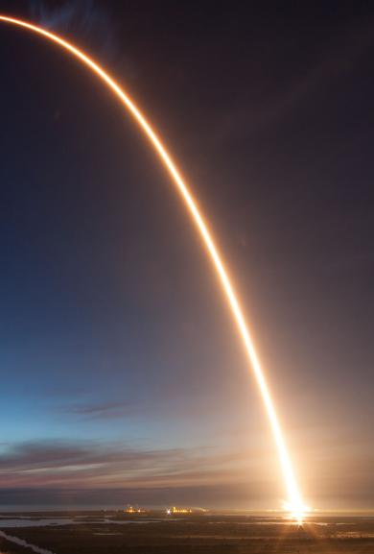
EDA with SQL
Using SQL, several queries were run to aggregate, isolate and filter out data in order to answer a few basics questions about the data and Falcon 9 launches. Queries to determine the following were all used:
Displaying the names of the unique launch sites in the space mission
Displaying 5 records where launch sites begin with the string ‘CCA’
Displaying the total payload mass carried by boosters launched by NASA (CRS)
Displaying average payload mass carried by booster version F9 v1.1
Listing the date where the successful landing outcome in ground pad was achieved.
Listing the names of the boosters which have success in drone ship and have payload mass greater than 4000 but less than 6000
Listing the total number of successful and failure mission outcomes
Listing the names of the Booster Versions, which have carried the maximum payload mass.
Listing the failed Landing Outcomes in drone ship, their booster versions, and launch site names in the year 2015.
Ranking the count of Landing Outcomes (such as Failure (drone ship) or Success (ground pad)) between the date 2010-06-04 and 2017-03-20, in descending order.
GitHub Notebook Link

Slide 13

Build an Interactive Map with Folium
Using Python’s Folium library, we also used an interactive map to visualize some of the data gathered. The following markers and objects were added to the map:
A Circle Marker was added to each Launch site, with a label for their names, using their latitude and longitude coordinates from the data. These were useful in seeing how close or far apart the launch sites were from each other.
A Cluster Marker was added to each launch site, labelling the number of launches. When clicked on, it also visualized how many of those launches were successful or not, with green markers for each successful launch and red markers for each failed launch. This made it easier to see which launch sites had higher success rates and frequencies.
Using the Haversine Formula, we also calculated the distance from the CCAFS SLC-40 launch to different landmarks, such as a nearby city, the coastline, or a highway. By placing PolyLine Markers, we could see how far a launch site was from these landmarks.
GitHub Notebook Link

Slide 14

Build a DASHBOARD WITH PLOTLY DASH
Using Python’s Dash library, we also interactive plots to visualize different aspect of the dataset.
By adding in interactive input options, the graphs would update to reflect different subsets of the data.
A drop-down menu listing the Launch Sites, and a slider for the Payload Mass were added.
The following visualizations were created for the dashboard:
Pie Charts:
The Pie Chart illustrated the distribution of launches per site by default. By interacting with the drop-down menu, an individual Launch Site could be selected. This would update the pie chart to show the distribution of Launch Outcomes for that Launch Site.
Scatter Plot:
The Scatter Plot illustrated the relationship between the Launch Outcomes and the Payload Mass. Booster Versions used was also represented by the color of the dots. The graph could be updated both by filtering which Launch Sites data to look at, as well as by filtering out payload masses below or above a value using the interactive slider.
GitHub Notebook Link

Slide 15
Predictive Analysis (Classification)
BUILDING THE MODEL
Load our dataset into NumPy and Pandas
Transform and Normalize Data
Split our data into training and test data sets
Check how many test samples we have
Decide which type of machine learning algorithms we want to use
Apply the parameters and algorithms to GridSearchCV
Fit the GridSearchCV Object to the training data set
EVALUATING THE MODEL
Check the accuracy of each model
Get the best hyperparameters for each type of algorithm
Plot the Confusion Matrix for each type of algorithm
IMPROVING THE MODEL
Feature Engineering
Algorithm Tuning
FINDING THE BEST PERFORMING CLASSIFICATION MODEL
The model with the best accuracy score wins the best performing model. This is returned with the best parameters to use for the algorithm as well.
GitHub Notebook Link

Slide 16
RESULTS
Exploratory data analysis results
Interactive analytics demo in screenshots
Predictive analysis results

Slide 17

EDA WITH VISUALIZATION

Slide 18
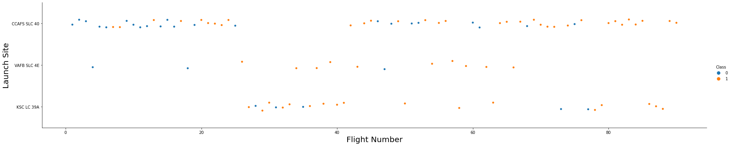
FLIGHT NUMBER VS. LAUNCH SITE
This scatter plot shows the relationship between the Flight Number and the Launch Site. It illustrates which Sites have had which flights, with the color of the dots representing the landing outcome. As you can see, CCAFD SLC 40 had a high success rate with the first few flights.

Slide 19
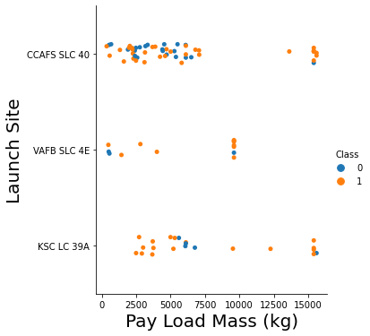
PAYLOAD MASS VS. LAUNCH SITE
This scatter plot shows the relationship between the Payload Mass and the Launch Site. It illustrates how heavy each payload has been at each site, with the color of the dots representing the landing outcome. As you can see, VAFB SLC 4E had flights with payload mass above 10,000kg.

Slide 20
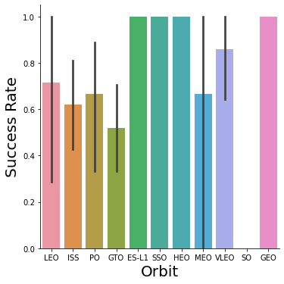
ORBIT TYPE VS. AVERAGE SUCCESS RATE
This bar plot shows how the average success rate of the landings varies per Orbit Type. As you can see, ES-LI, SSO, HEO, and GEO have the best success rates amongst the orbit types.

Slide 21
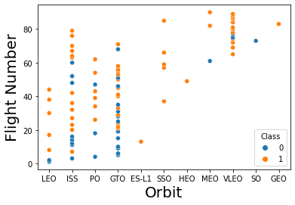
ORBIT TYPE VS. FLIGHT NUMBER
This scatter plot shows the relationship between the Flight Number and the Orbit Type. With the color of the dots representing the landing outcome, the graph illustrates the average success rate per orbit type, by flight number. As you can see, LEO orbit flights’ success rate appears to be correlated to the number of flights, while the GTO orbit flights’ success rate has no obvious relationship.
21

Slide 22
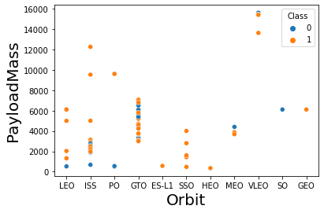
ORBIT TYPE VS. PAYLOAD MASS
This scatter plot shows the relationship between the Payload Mass and the Orbit Type. With the color of the dots representing the landing outcome, the graph illustrates the average success rate per orbit type, by payload mass. As you can see, LEO, ISS, and PO orbit flights’ success rate appears to be correlated to the number of flights, while the GTO orbit flights’ success rate has no obvious relationship.
22

Slide 23
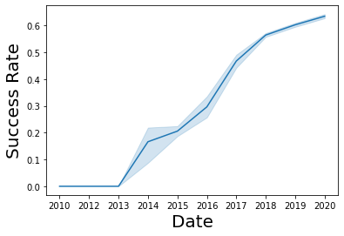
YEAR VS AVERAGE SUCCESS RATE
This line plot shows how the average success rate of flights has changed over time. As you can, since 2013, there has been an overall positive trend in the average success rate since 2013.
23

Slide 24

EDA with SQL

Slide 25
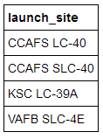
ALL LAUNCH SITE NAMES
SQL Query:
SELECT
DISTINCT(LAUNCH_SITE)
FROM
SPACEXTBL
How it works:
By using the DISTINCT function in the SELECT clause, only unique values from the LAUNCH_SITE column will appear in the result.

Slide 26
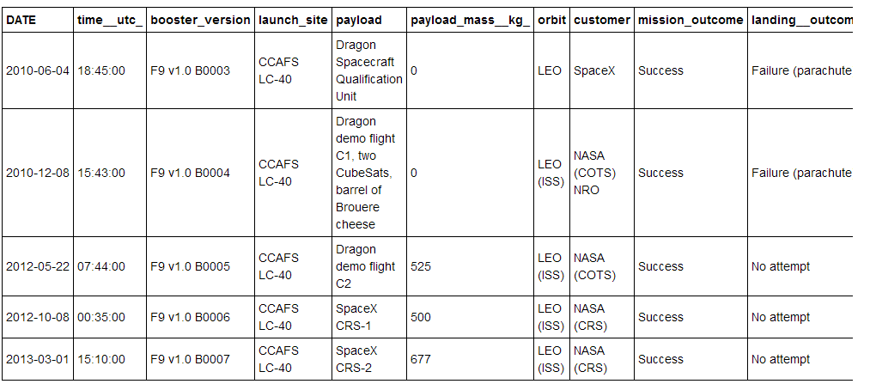
LAUNCH SITE NAMES THAT BEGIN WITH ‘CCA’
SQL Query:
SELECT
*
FROM
SPACEXTBL
WHERE
LAUNCH_SITE LIKE ‘CCA%’
LIMIT 5
How it works:
By using the LIKE function and WILDCARDS in the WHERE clause, we can filter out results by only including rows where the launch site starts with ‘CCA’.
Then we can filter out only 5 records using the LIMIT clause.

Slide 27
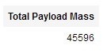
TOTAL PAYLOAD MASS BY CUSTOMER NASA (CRS)
SQL Query:
SELECT
SUM(PAYLOAD_MASS__KG_) AS “Total Payload Mass”
FROM
SPACEXTBL
WHERE
CUSTOMER = ‘NASA (CRS)’
How it works:
By using the SUM function in the SELECT clause, we can add up the mass off all payloads in the dataset.
With the WHERE clause we can filter the dataset to only include the payloads by ‘NASA (CRS) as the customer.

Slide 28
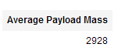
AVERAGE PAYLOAD MASS BY BOOSTER VERSION F9 v1.1
SQL Query:
SELECT
AVG(PAYLOAD_MASS__KG_) AS “Average Payload Mass”
FROM
SPACEXTBL
WHERE
BOOSTER_VERSION = ‘F9 v1.1’
How it works:
By using the AVG Function in the SELECT clause, we can obtain the average of all the payload masses in the dataset.
With the WHERE clause we can filter the dataset to only include the payloads with ‘F9 v1.1’ as their Booster Version.

Slide 29
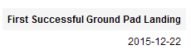
DATE OF THE FIRST SUCCESSFUL GROUND PAD LANDING
SQL Query:
SELECT
MIN(DATE) AS “First Successful Ground Pad Landing”
FROM
SPACEXTBL
WHERE
Landing_Outcome = ‘Success (Ground Pad)’
How it works:
By using the MIN Function in the SELECT clause, we can obtain the earliest launch date in the dataset.
With the WHERE clause we can filter the dataset to only include the dates where the launch had a successful ground pad landing.

Slide 30
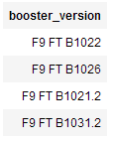
SUCCESSFUL DRONE SHIP LANDING WITH RESTRICTED PAYLOAD MASS
SQL Query:
SELECT
BOOSTER_VERSION
FROM
SPACEXTBL
WHERE
Landing_Outcome = ‘Success (Drone ship)’
and PAYLOAD_MASS__KG_ > 4000
and PAYLOAD_MASS__KG_ < 6000
How it works:
With the WHERE clause, we can set multiple filters using the AND operator. This way, we can filter out the dataset to only include Booster Versions of launches that had successful drone ship landings and have a Payload Mass between 4000-6000 (not inclusive).

Slide 31
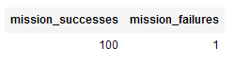
TOTAL NUMBER OF SUCCESSFUL AND FAILED MISSION OUTCOMES
SQL Query:
SELECT
COUNT(CASE WHEN MISSION_OUTCOME LIKE 'Success%’ THEN 1 ELSE NULL END) as mission_successes,
COUNT(CASE WHEN MISSION_OUTCOME LIKE 'Failure%’ THEN 1 ELSE NULL END) as mission_failures
FROM
SPACEXTBL
How it works:
The CASE Function lets us encode the mission outcome column with values that we choose. In this query, we encode the successes and failures as 1’s.
Then the COUNT Function can count all the rows with 1’s in each case respectively and sum up the totals.

Slide 32
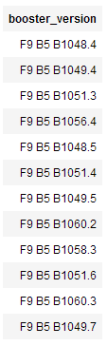
BOOSTERS VERSIONS THAT HAVE CARRIED THE MAXIMUM PAYLOAD
SQL Query:
SELECT
BOOSTER_VERSION
FROM
SPACEXTBL
WHERE
PAYLOAD_MASS__KG_ = (select max(PAYLOAD_MASS__KG_) from SPACEXTBL)
How it works:
The WHERE clause in this query utilizes a sub-query to filter the dataset on.
The sub-query used implements the MAX Function in the SELECT clause to retrieve the maximum payload mass used in a flight in the entire dataset.

Slide 33
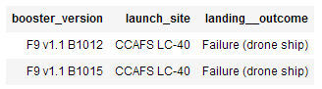
BOOSTER VERSIONS OF FAILED DRONE SHIP LANDINGS IN 2015
SQL Query:
SELECT
BOOSTER_VERSION,
LAUNCH_SITE,
LANDING__OUTCOME
FROM
SPACEXTBL
WHERE
LANDING__OUTCOME = 'Failure (drone ship)' AND YEAR(DATE) = '2015’
How it works:
The WHERE clause alongside the AND Operator filters out the dataset to only include failed drone ship landings in 2015.
The SELECT CLAUSE retrieves the Booster Version, Launch Site, and Landing Outcome of each record in the filtered dataset.

Slide 34
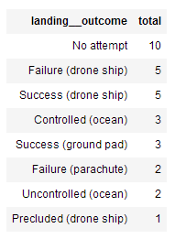
BOOSTER VERSIONS OF FAILED DRONE SHIP LANDINGS IN 2015
SQL Query:
SELECT
LANDING__OUTCOME,
COUNT(LANDING__OUTCOME) AS Total
FROM
SPACEXTBL
WHERE
DATE BETWEEN '2010-06-04' AND '2017-03-20’
GROUP BY
LANDING__OUTCOME
ORDER BY
Total DESC
How it works:
The WHERE clause filters out the dataset to only include records from 2016-06-04 till 2017-04-20.
The SELECT CLAUSE retrieves the Landing Outcome and the number of Landing Outcomes by using the COUNT Function of each record in the filtered dataset.
The GROUP BY clause groups records up by the type of landing outcome.

Slide 35


INTERACTIVE MAPS WITH FOLIUM

Slide 36
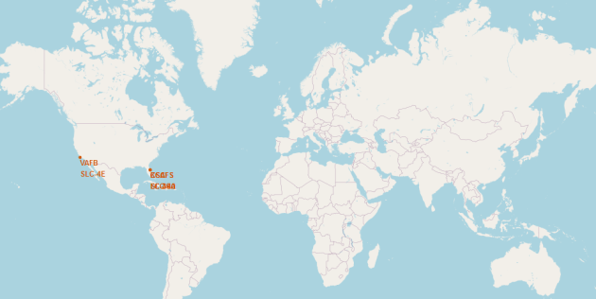
LAUNCH SITES via FOLIUM
It is very evident that all Falcon 9 Launches have taken place in the USA, with launch sites on both the west coast (California) and the east coast (Florida).

Slide 37
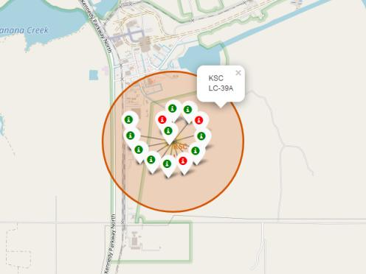
SUCCESSFUL LANDINGS via FOLIUM
Cluster of Landing Outcomes at the KSC LC-39A Launch Site. The Green Markers represent flights with successful landings. The Red Markers represent failed landings.

Slide 38

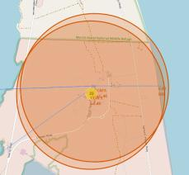
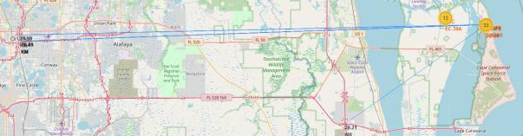
LAUNCH SITE DISTANCE TO LANDMARKS
PolyLine Markers displaying the distance from the CCAFS Launch sites, to landmarks such as the coast line, railways, highways and cities.
As you can see, the Launch sites are not within close proximity to any of the above landmarks besides the coastline.

Slide 39

Plotly Dashboard

Slide 40
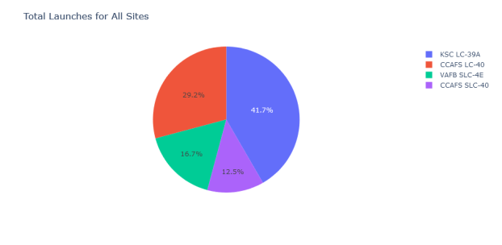
PLOTLY DASHBOARD – LAUNCH SITES
Pie Chart of the number of launches from each Launch Site.
As you can see, the KSC LC-39A Launch Site has produced the most Falcon 9 launches.

Slide 41
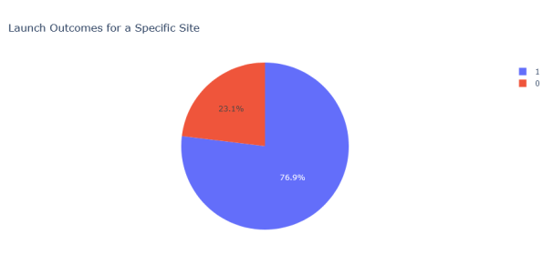
PLOTLY DASHBOARD – LAUNCH OUTCOMES
Pie Chart of the number of launch outcomes from the KSC LC-39A Launch Site.
As you can see over 75% launches from this launch site have a successful outcome.

Slide 42
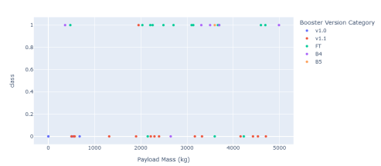
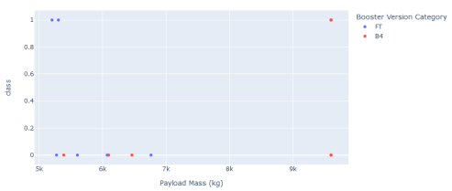
PLOTLY DASHBOARD – LAUNCH OUTCOMES
Scatter Plots of Low Weighted Payloads (0-5000kg) (top), and High Weighted Payloads (5000-10000) (bottom).
As you can see, the success rates for lower weighted payloads is higher in comparison to higher weighted payloads.

Slide 43

Predictive analysis - classification

Slide 44
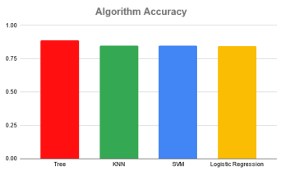
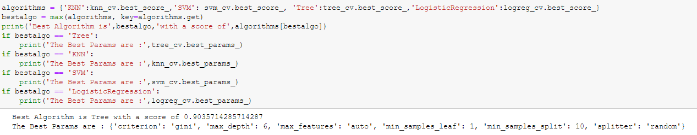
Classification Accuracy
As you can, that despite each algorithm producing nearly equal accuracy, the Classifier Tree Model is the most accurate model for the given data.

Slide 45
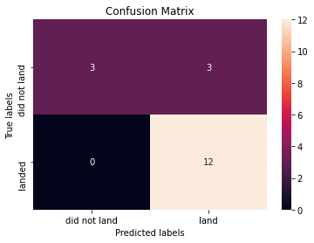
DECISION TREE - CONFUSION MATRIX
As you can see from the confusion matrix, the model has a very high accuracy in terms of predicting True Positives, so it can tell the classes apart.
However there is a problem with the model because we can also see that it also predicts False Positives too often.

Slide 46
Conclusions
KSC LC-39A has had the most successful launches.
GEO, HEO, SSO, ES-L1 Orbits have the best average success rates.
Lower Weighted Payloads (< 5000kg) have higher success rates than heavier payloads.
A DecisionTree Classifier Algorithm is the best model for predicting success rates given this data set, with a near 90% accuracy on the training data.

